Slide 1
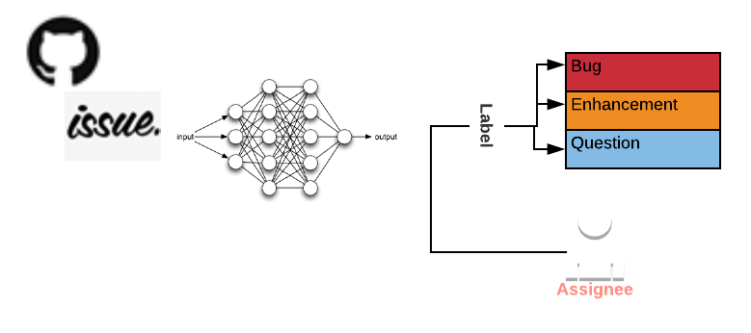
Recommending Assignee-label for Github Issue through Deep Neural Networks
Work in Progress Paper….
TestData Project Links

Slide 2
Outlines
Background
Usage
Motivation
Traditional approaches
Our Approach
Evaluation

Slide 3
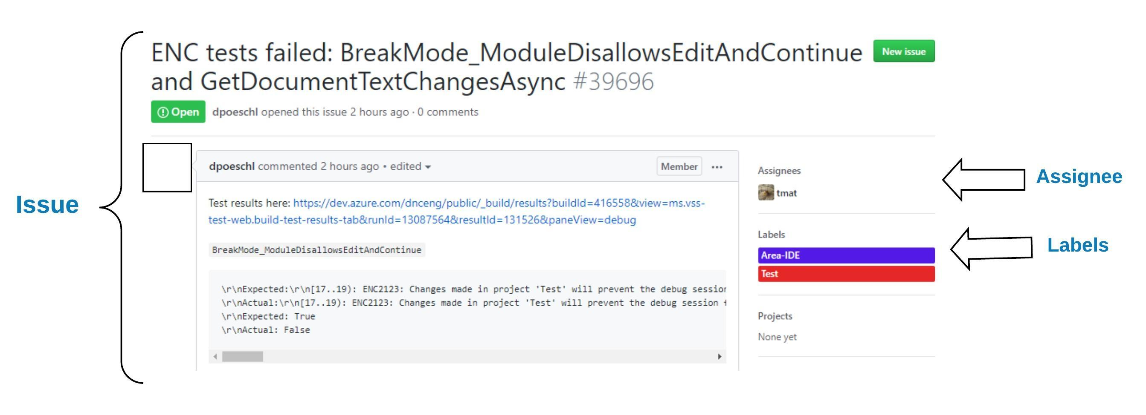
Background
GitHub – is a web-based software development version control system
which support varying level of software management support
(e.g., issue-tracker, pull request, version control system)
Fig. A issue report from Roslyn project (GitHub, 2019)

Slide 4
Usage
To monitor the software performance
statistics of bug labelled issues
detect the high-level code smell area of the system
Useful for resource allocations
finding appropriate developer for a new issue
monitor overall performance of developers by reviewing no of fixed issues

Slide 5
Motivation

Slide 6
Issue-Assignee & Issue-Label Links Maintenance Challenges
Time-consuming and laborious
Need prior knowledge of the system
Forget to record
Delay in fixing issues
Impact on project statistics
Example Issues Statistics from Roslyn GitHub Project
No. of Labels = 56 | No. of Contributors = 138
(GitHub, 2019)

Slide 7
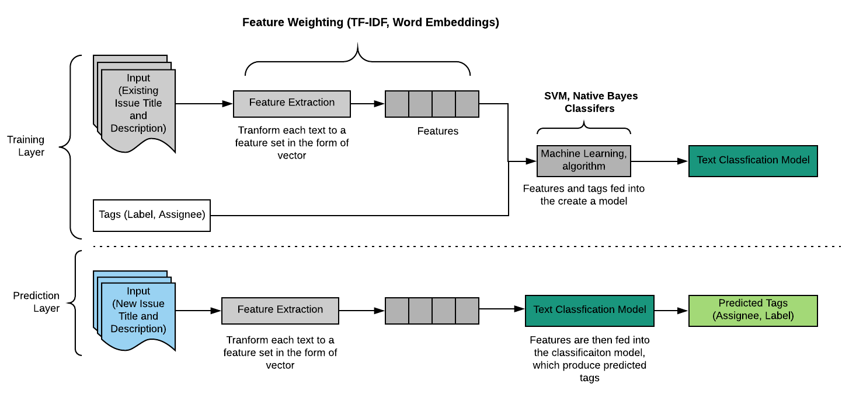
Traditional approaches
Multiclass text classification – automated sorting of texts into categories according to its content.
Notes:
This the summarize workflow version of previous studies techniques.

Slide 8

Features Extraction
1 | Input | Sentence 1 = ‘issue one report’ Sentence 2 = ‘issue two report’
2 | Features Extraction (Corpus) | ['issue', 'one', 'report', 'two'] {'issue': 0, 'report': 2, 'one': 1, 'two': 3}
3 | Features – TF/IDF | (0, 1) 0.7049094889309326 (0, 2) 0.5015489070943787 (0, 0) 0.5015489070943787 –issue (1, 3) 0.7049094889309326 (1, 2) 0.5015489070943787 (1, 0) 0.5015489070943787 –issue

Slide 9
Drawbacks of Current Features Extraction
Current features extraction techniques (TF-IDF) are based on the mathematical and concrete rather than expressive, However, issues report are written in free text format and ambiguous
Lost of context
Eg. “I arrived at the bank after crossing the road.”
“I arrived at the bank after crossing the river.”
Sensitive to misspelling
Insensitive of words order in the sentence
Eg, Don’t remove the number from the cell, I want it in here
-VS-
I don’t want the number in the cell, remove it from here
Notes:
Word Vectors are designed to capture meaning of the words

Slide 10
Our Approach

Slide 11
Our Approach & Contributions
Sentence Embeddings – based on transformer (Vaswani et al. 2017) self-attention mechanisms based encoder. It can compute the context aware representation of words in a sentence.
Sequential Neural Networks – use deep learning neural networks as a classifier to predict the assignee and label for a new issue report
we propose a neural network-based recommendation system to automatically predict assignee-label for a new issue report
we present a transferable issue-label prediction model which can reuse in similar issue tracking projects

Slide 12
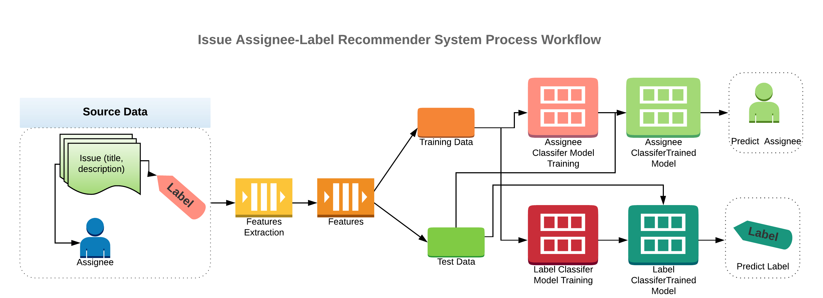
High Level Process Flow
Sentence Embeddings (Transformer Encoder)
Sequential Neural Networks for Classification

Slide 13
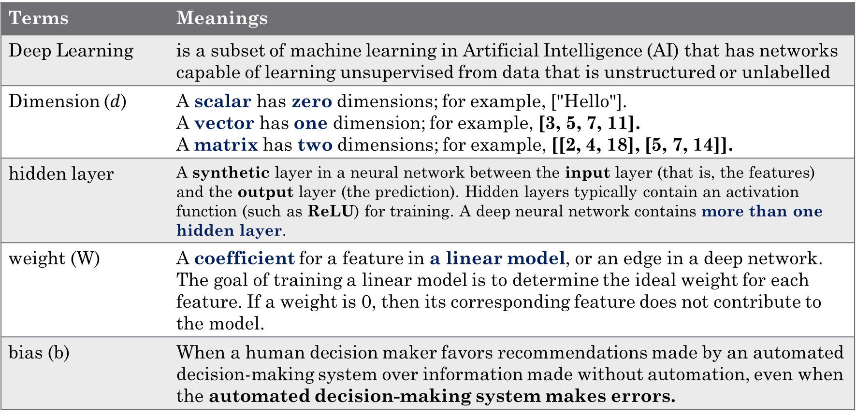
Prerequisites Terms/Terminology for Deep Learning Neural Networks (Part 1/2)
Terms | Meanings
Deep Learning | is a subset of machine learning in Artificial Intelligence (AI) that has networks capable of learning unsupervised from data that is unstructured or unlabelled
Dimension ($d$) | A scalar has zero dimensions; for example, ["Hello"]. A vector has one dimension; for example, [3, 5, 7, 11]. A matrix has two dimensions; for example, [[2, 4, 18], [5, 7, 14]].
hidden layer | A synthetic layer in a neural network between the input layer (that is, the features) and the output layer (the prediction). Hidden layers typically contain an activation function (such as ReLU) for training. A deep neural network contains more than one hidden layer.
weight (W) | A coefficient for a feature in a linear model, or an edge in a deep network. The goal of training a linear model is to determine the ideal weight for each feature. If a weight is 0, then its corresponding feature does not contribute to the model.
bias (b) | When a human decision maker favors recommendations made by an automated decision-making system over information made without automation, even when the automated decision-making system makes errors.
(Google Machine Learning Glossary, 2019)(Wikipedia, 2019)
Notes:
Neuron – in simple term perform addition and multiplication with the inputs and pass the unit into the activation function.
Bias – is a another constant number like weight, it take into account machine error

Slide 14
Prerequisites Terms/Terminology for Deep Learning Neural Networks (Part 2/3)
Terms | Meanings
Activation Function | A function (for example, ReLU or sigmoid) that takes in the weighted sum of all of the inputs from the previous layer and then generates and passes an output value (typically nonlinear) to the next layer.
Rectified Linear Unit (ReLU) | An activation function with the following rules: If input is negative or zero, output is 0. If input is positive, output is equal to input.
sigmoid | An activation function that maps logistic or multinomial regression output (log odds) to probabilities, returning a value between 0 and 1. The sigmoid function has the following formula:
softmax | A function that provides probabilities for each possible class in a multi-class classification model. The probabilities add up to exactly 1.0. For example, softmax might determine that the probability of an issue report being a bug at 0.9, a question at 0.08, and a enhancement at 0.02.
(Google Machine Learning Glossary, 2019)(Wikipedia, 2019)

Slide 15
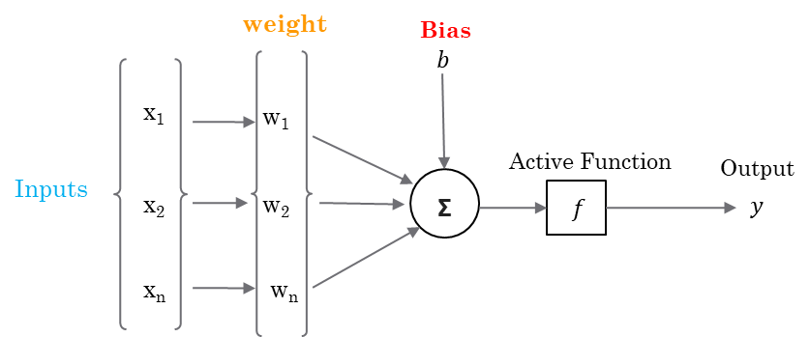
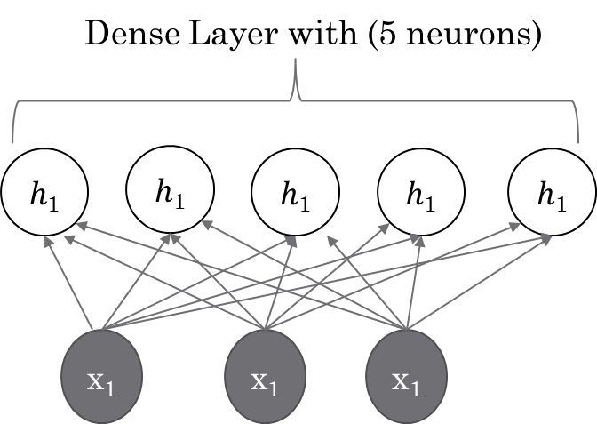
Prerequisites Terms/Terminology for Deep Learning Neural Networks (Part 3/3)
Neural Networks - Neuron
Full connected layer
(Dense Layer)
Word Embedding
University
Student
School
Lecturer
is a basic “computational cell” of a neural networks.
Word feature learning techniques in natural language processing (NLP) where words or phrases from the vocabulary are mapped to vectors of real numbers.
Neurons in a fully connected layer have connections to all activations in the previous layers.
Wikipedia, 2019
Notes:
Neturon – a neuron takes inputs from the left called X in this diagram, it multiples it with a weight, which is the another number. Then, it added up all the multiplication with bias and passes these result through which is activation function. There three basic activation function used in neural network (sigmoid, tanh, and ReLU Rectified Linear Unit). Sigmoid – is the logistic function which can range the results between -1 and 1. Tanh – is stand for hyperbolic tangent function, which compute the input vectors using cosine and sine function (1,0). Rectified Learn Unit is also known as ramp function (0,1).
Dense Layer – also called as fully connext
Word Embedding – a method to capture the representations of words in 2D or 3D dimensional vector space by transforming a word into N-dimensional vector. Most popular word embeddings methods (skip gram or continuous bag of word method), which compute the representation of words by using fixed-length window.

Slide 16
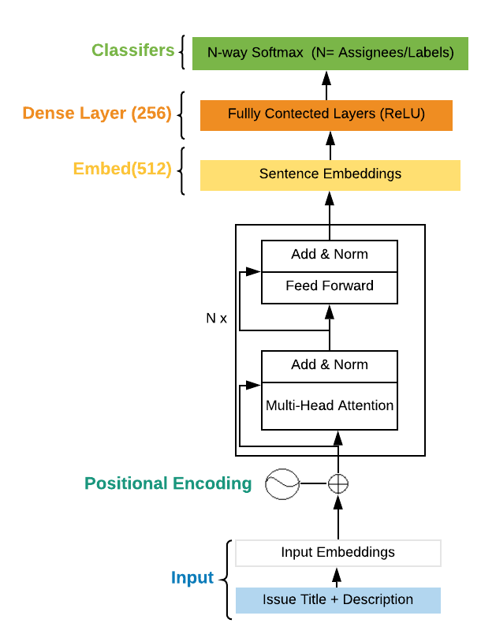
Feature Extraction and Classification Architecture
3
Sequential Neural Networks for Classification
2.2
2
2.1
Sentence Embeddings (Transformer Encoder)
1

Slide 17
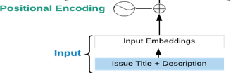

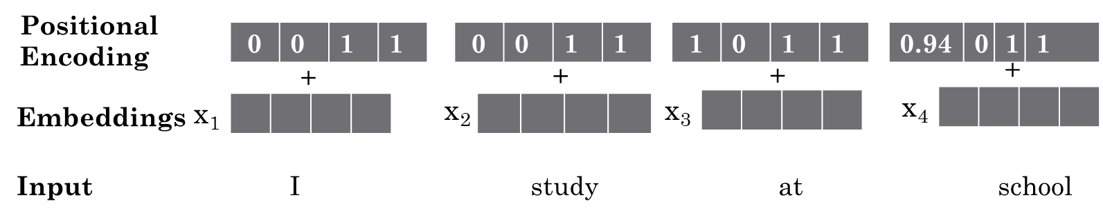
Positional Encoding
1
Purpose – is to keep track of the current input position in the sequence
pos | Position
i | Dimension correspond to sinusoid or sine wave
d_{model} | Dimension of embeddings
Notes:
Relative positional encoding can encode with any size of input sequence.

Slide 18

Self-Attention Layer
2
The key concept of transformer neural networks is parallelization, which make it difference from existing neural networks such as recurrent neural networks (RNN) or Convolutional Neural Networks (CNN). It avoid recurrence process.
Self attention layer – all the keys, values and queries come from the same place, in this case, the output of the previous layer in the encoder. Each position in the encoder can attend to all the positions in the previous layers of the encoder. (Vaswani et al. 2017)
In simple terms, what self-attention try to achieve is relating all the words (positions)in the sentence (sequence) to compute a better representation of the current word (position). It tries to interpret the meaning of the word like a human.
E.g. I arrived at the bank after crossing the road.

Slide 19
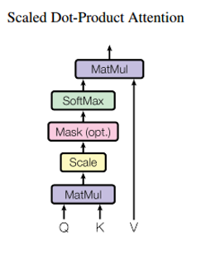
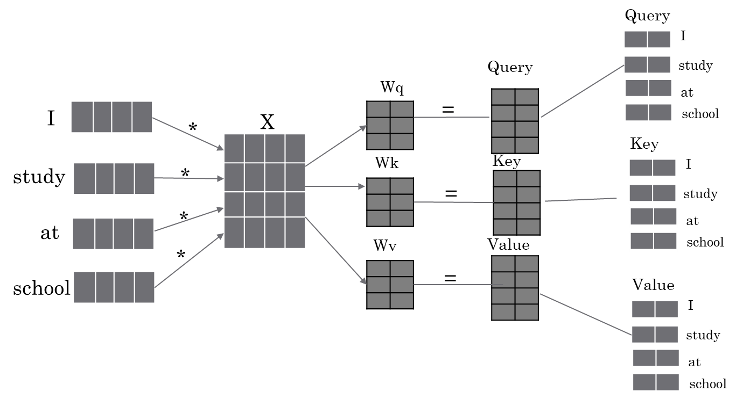

Scale-dot Attention (1/2)
2.1
1. Generate values for Query (Q), Key (K) and Value(V)
Q | Query
K | Key
V | Value
d_{k} | Dimension of key
Notes:
The two most commonly used attention function are additive attention and dot-product (multiplicative) attention.
Try to calculate the vector representation of the all the word in the sequemce.

Slide 20
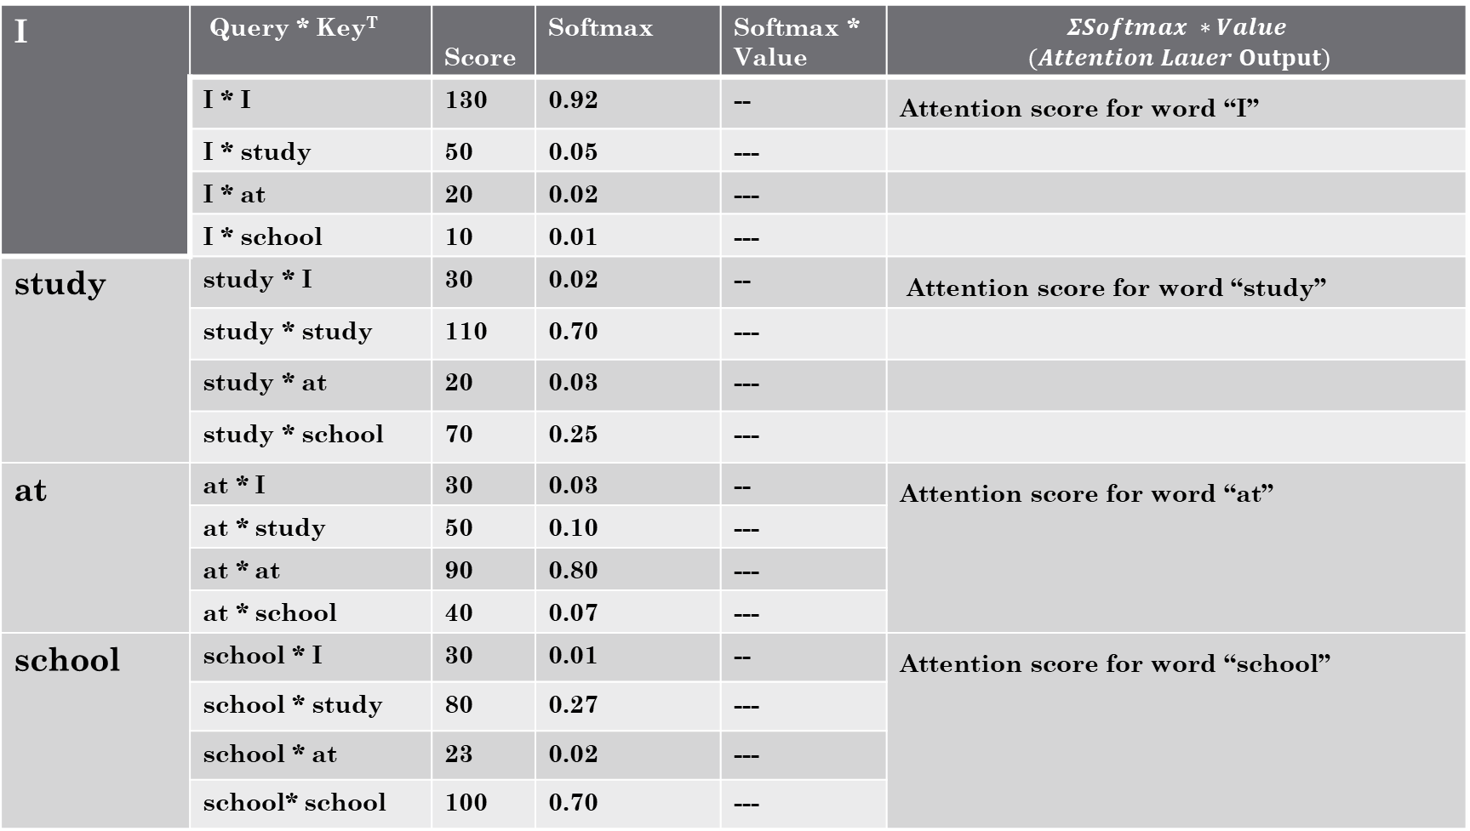
2.1
Scale-dot Attention (2/2)
I | Query * Key^{T} | Score | Softmax | Softmax * Value | $$ΣSoftmax ∗Value$$ $$(Attention Lauer Output)$$
 | I * I | 130 | 0.92 | -- | Attention score for word “I”
 | I * study | 50 | 0.05 | ---
 | I * at | 20 | 0.02 | ---
 | I * school | 10 | 0.01 | ---
study | study * I | 30 | 0.02 | -- | Attention score for word “study”
 | study * study | 110 | 0.70 | ---
 | study * at | 20 | 0.03 | ---
 | study * school | 70 | 0.25 | ---
at | at * I | 30 | 0.03 | -- | Attention score for word “at”
 | at * study | 50 | 0.10 | ---
 | at * at | 90 | 0.80 | ---
 | at * school | 40 | 0.07 | ---
school | school * I | 30 | 0.01 | -- | Attention score for word “school”
 | school * study | 80 | 0.27 | ---
 | school * at | 23 | 0.02 | ---
 | school* school | 100 | 0.70 | ---

Slide 21
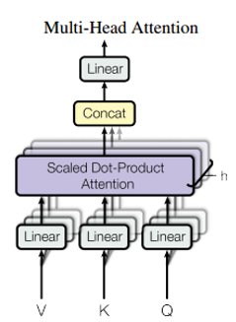
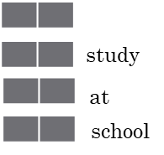

Multi-head Attention – parallel attention layers
Output
I
*
Wº
h | 8
Wº
d_{model} | 512
(Vaswani et al. 2017)
Notes:
real numbers set

Slide 22


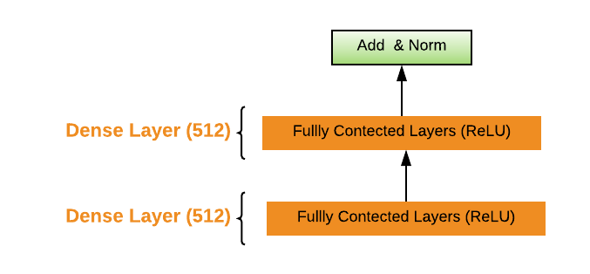
Position-wise Feed-Forward Networks
2.2
Add & Norm - Layer normalization is similar batch normalization, but the mean and variances are calculated along the last dimension,

Slide 23
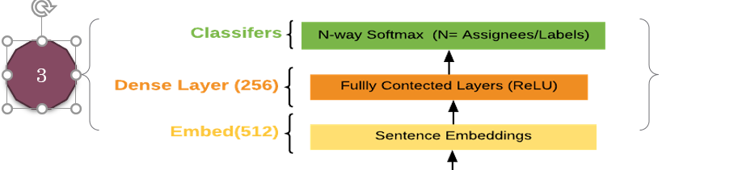
softmax | A function that provides probabilities for each possible class in a multi-class classification model. The probabilities add up to exactly 1.0. For example, softmax might determine that the probability of an issue report being a bug at 0.9, a question at 0.08, and a enhancement at 0.02.

Slide 24
Evaluation
 | Issues(issue + pull request) | Label | Assignee/Contributor
SVF | 92 | 6 | 7
corefix | 15000 | 126 | 40
Roslyn | 20000 | 138 | 56

Slide 25
Assignee-Issue Prediction Results (In Progress)
Datasets | Features | Precision | Recall | F-Measure | Accuracy
SVF | Title | 45 | 50 | 47 | 89
 | Title + Description | 45 | 50 | 47 | 89
Roslyn | Title | 10 | 12 | 11 | 34
 | Title + Description | 16 | 16 | 15 | 36

Slide 26
Label-Issue Prediction Result (In Progress)
Datasets | Features | Precision | Recall | F-Measure | Accuracy
SVF | Title | 12 | 16 | 14 | 32
 | Title + Description | 18 | 21 | 19 | 37
Roslyn | Title | 17 | 19 | 18 | 66
 | Title + Description | 19 | 19 | 19 | 68

Slide 27
References
Github. (2019). dotnet/roslyn. [online] Available at:https://github.com/dotnet/roslyn/
https://github.com/dotnet/roslyn/issues/39696
https://monkeylearn.com/text-classification/
https://www.commonlounge.com/discussion/99e86c9c15bb4d23a30b111b23e7b7b1
https://medium.com/@bedigunjit/simple-guide-to-text-classification-nlp-using-svm-and-naive-bayes-with-python-421db3a72d34
Transformer
http://jalammar.github.io/illustrated-transformer/
Text Classification
https://www.youtube.com/watch?v=KcS6nVUT3Gc&t=574s
Terms & Glossary
https://developers.google.com/machine-learning/glossary
My Github Project
https://github.com/thazin31086/GitHub_NeturalNetworks

Slide 28
Thank you

